Slide 1


Projektowanie rozwiązań w oparciu o Azure, czyli nowe wyzwania Twojego zespołu.
Piotr Rogala

Slide 2
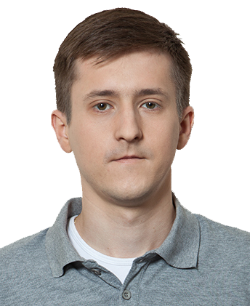


About Me
Current working in UNIT4
Team Lead Cloud Operations
MVP Azure
Blog: justcloud.pl
FB Page: facebook.com/justcloudpl
Group leader:
Microsoft Azure User Group Poland

Slide 3

Wrocławska Grupa Microsoft Azure User Group Poland
https://www.meetup.com/Microsoft-Azure-Users-Group-Poland
https://www.facebook.com/groups/azureugpl

Slide 4






Grupy we Wro
CloudPoland
http://slack.justcloud.pl
DevOps Wrocław
https://www.meetup.com/Wroclaw-DevOps-Meetup
PPOSH
https://www.meetup.com/Polish-PowerShell-Group-PPoSh
Wrocław .NET User Group
https://www.meetup.com/wrocnet
MAUGP
http://azureug.org
SysOps Polska
https://www.meetup.com/SysOpsPolska

Slide 5
Agenda
A Project in Cloud
Team Challenges
What is the problem?
DevOps
Challenges part 2
Tools
Automation

Slide 6
A Project in Cloud

Slide 7
Project in Cloud - assumptions
Deadline is next month
All clicked in portal – because it’s faster!
Manual work is better…
Based on IaaS – we know this solution!
You can copy paste APP from on-promise
Services? What is it?

Slide 8


Slide 9
Team Challenges

Slide 10
Challenges
The size of the team
The lack of Specialists
Long Life Learning
Courses / Certificates
Knowledge sharing

Slide 11
What's the problem?

Slide 12
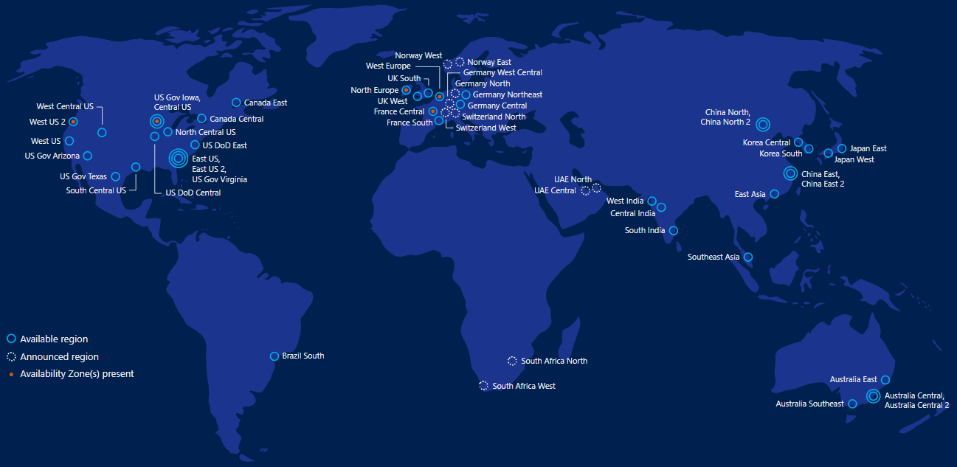

Azure
Public Cloud (Azure)
Private Cloud (Azure Stack)
Regions Worldwide: 54
Cost: Pay-as-you-go
Services: Ready to use
Simple / Quick start

Slide 13
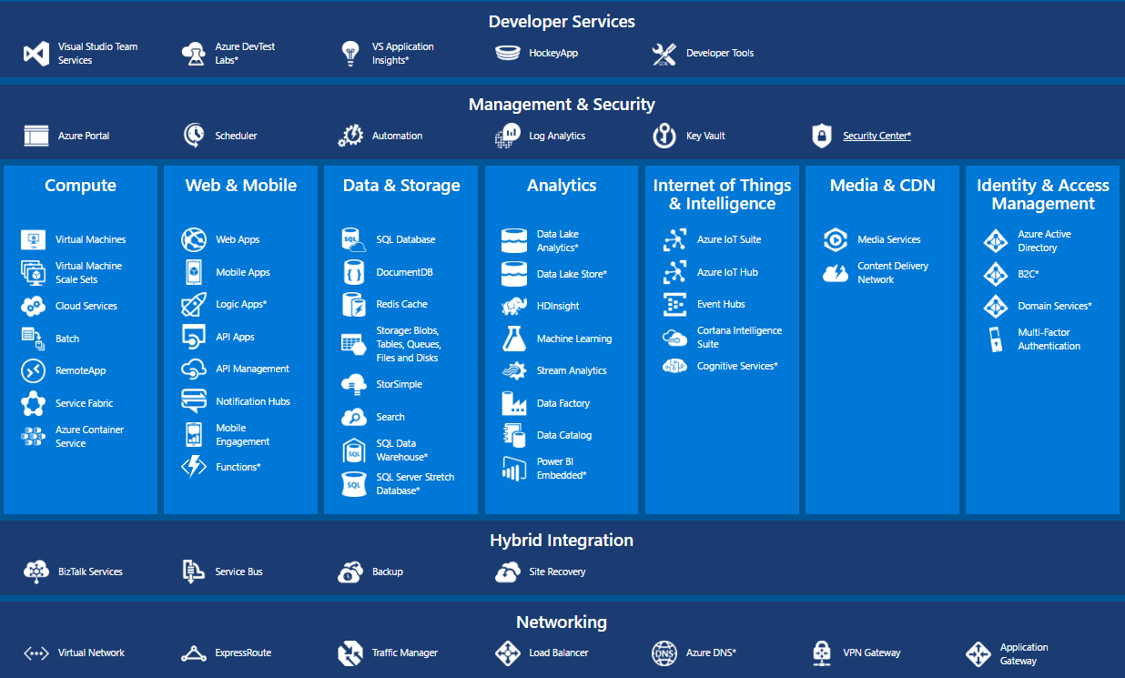

Slide 14
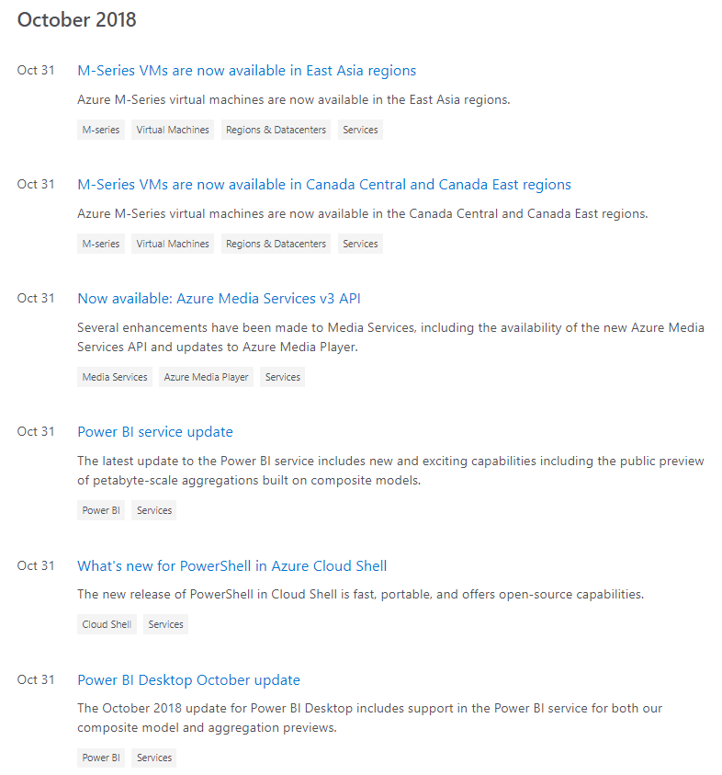
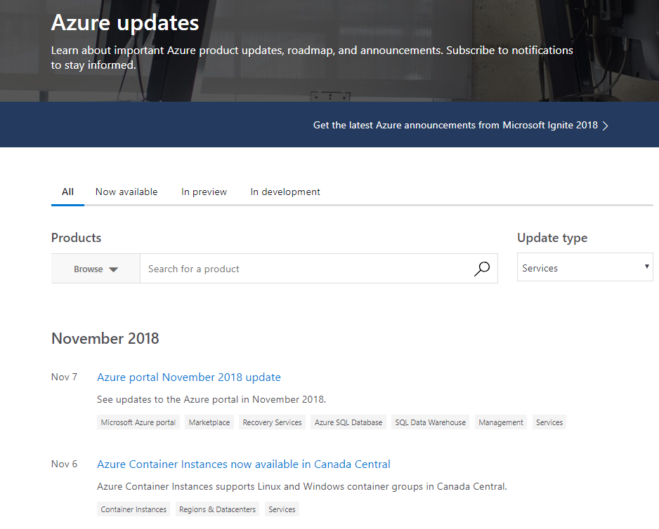

Slide 15
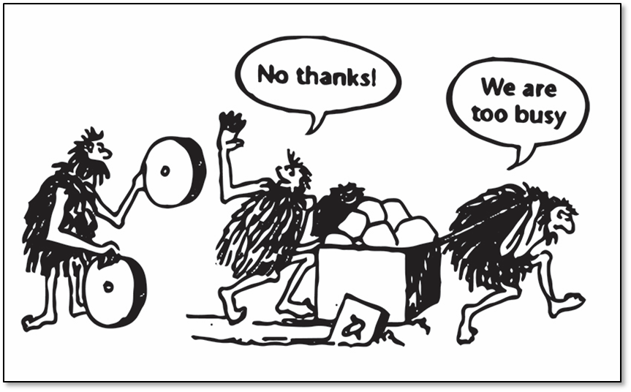

Slide 16
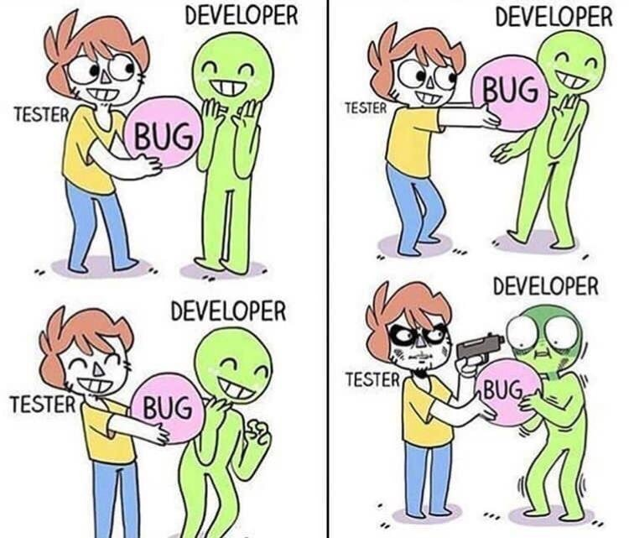

Slide 17
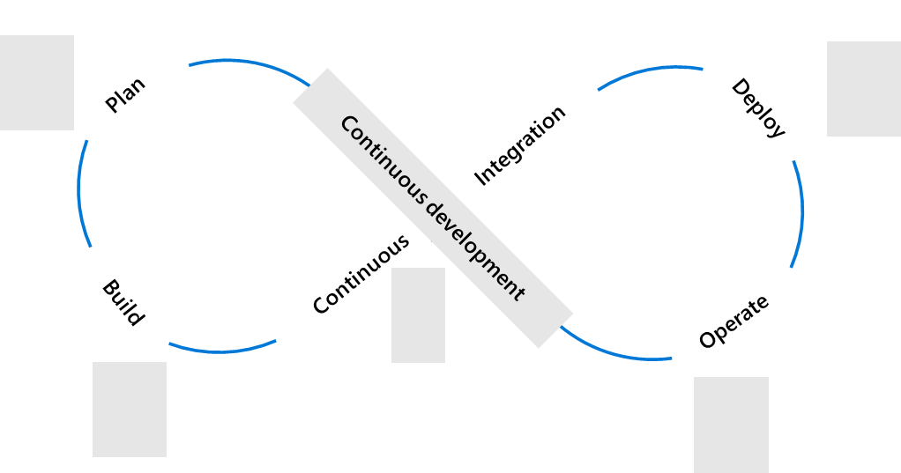
Plan + Track
Release
Development
Operations
Code, Build + Test
Operate + Monitor

Slide 18
What is DevOps?
People. Process. Products.
Build& Test
Deploy
DevOps is the union of people, process, and products to enable continuous delivery of value to your end users.
“
Continuous Delivery
Develop
Operate
”
Plan & Track
Monitor & Learn

Slide 19
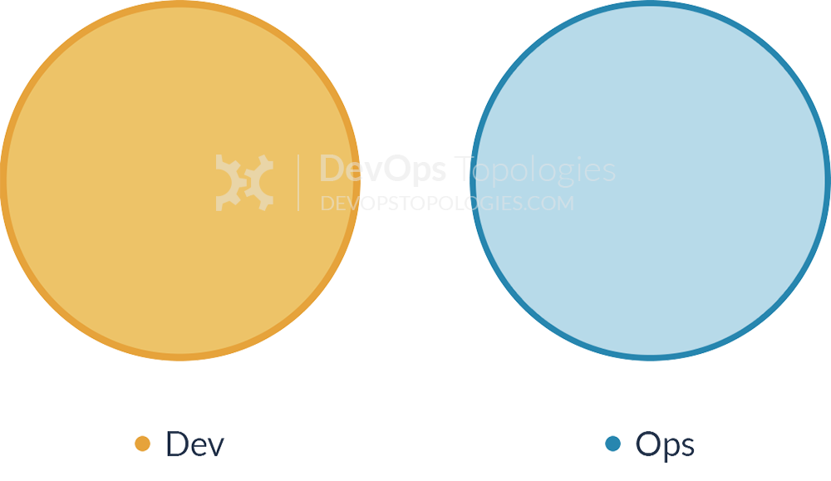
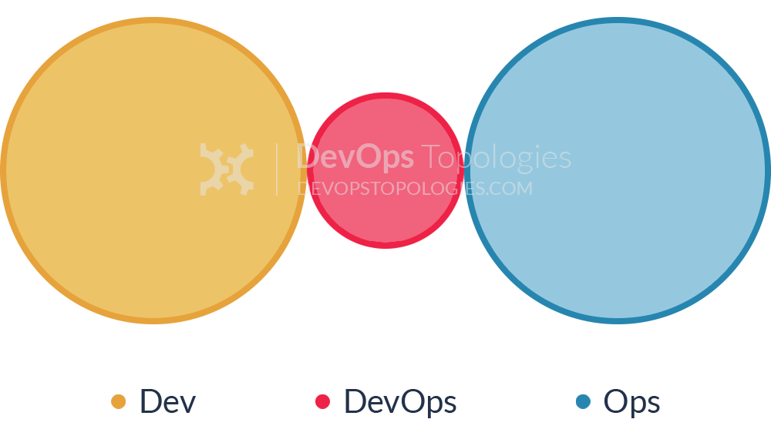
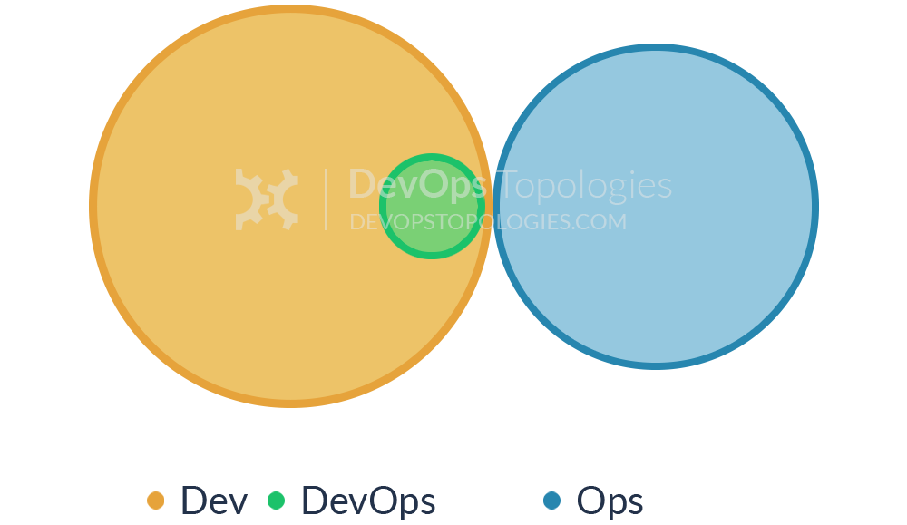
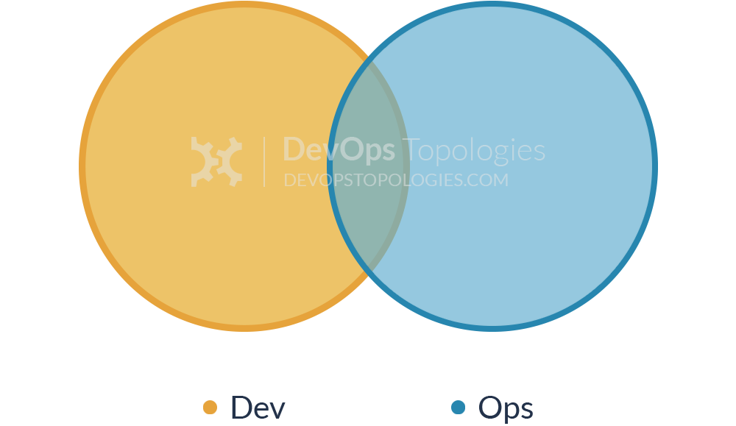
Anti-Type
Anti-Type
Potential effectiveness: HIGH
Potential effectiveness: MEDIUM

Slide 20
Challenges
The size of the team
The lack of Specialists
Long Life Learning
Courses / Certificates
Knowledge sharing
The collaboration or integration with another teams (Dev < > Ops)
Simple or smart process for working

Slide 21
But…

Slide 22
Common problems
No time for review services
No time for optimization (low performance)
No automation
No planning time, lack of standards
No estimated cost – no scalling solutions (24/7 working)
No time for testing
Next project cannot be based on previous
We will do it better next time…
We don’t think about new solutions, services, technologies

Slide 23


Slide 24

Tools
To plan a project
Time to develop skills
Effective communication
Tools integration
Methodology

Slide 25
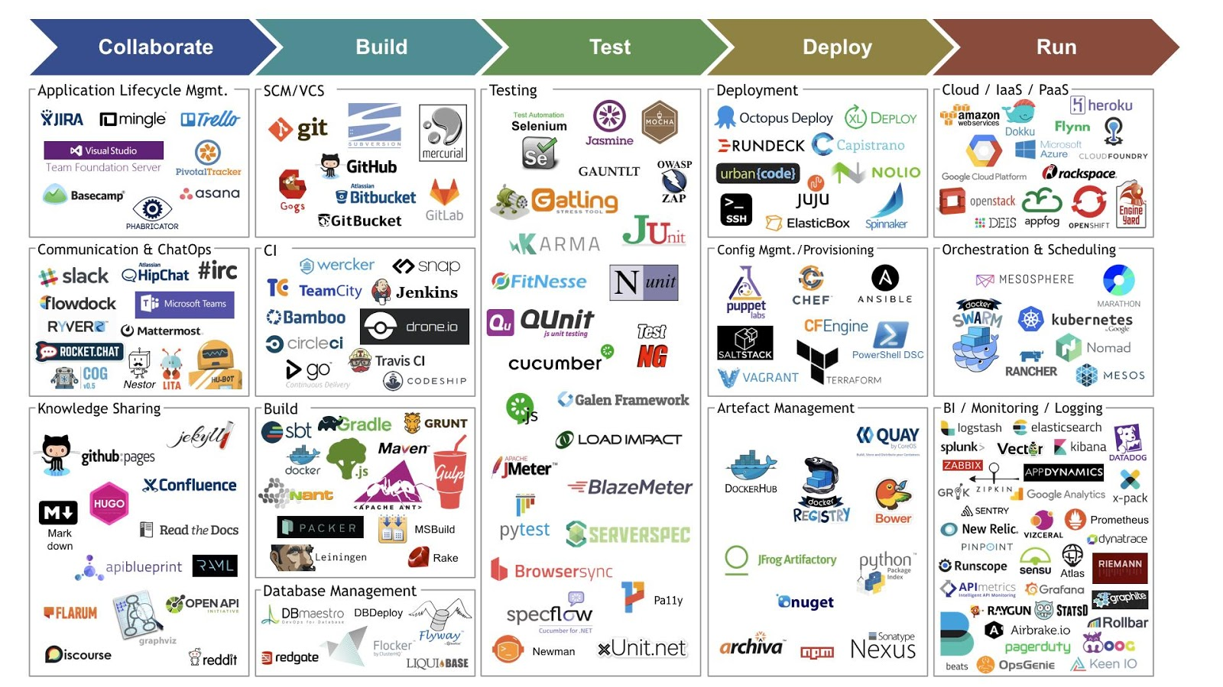

Slide 26
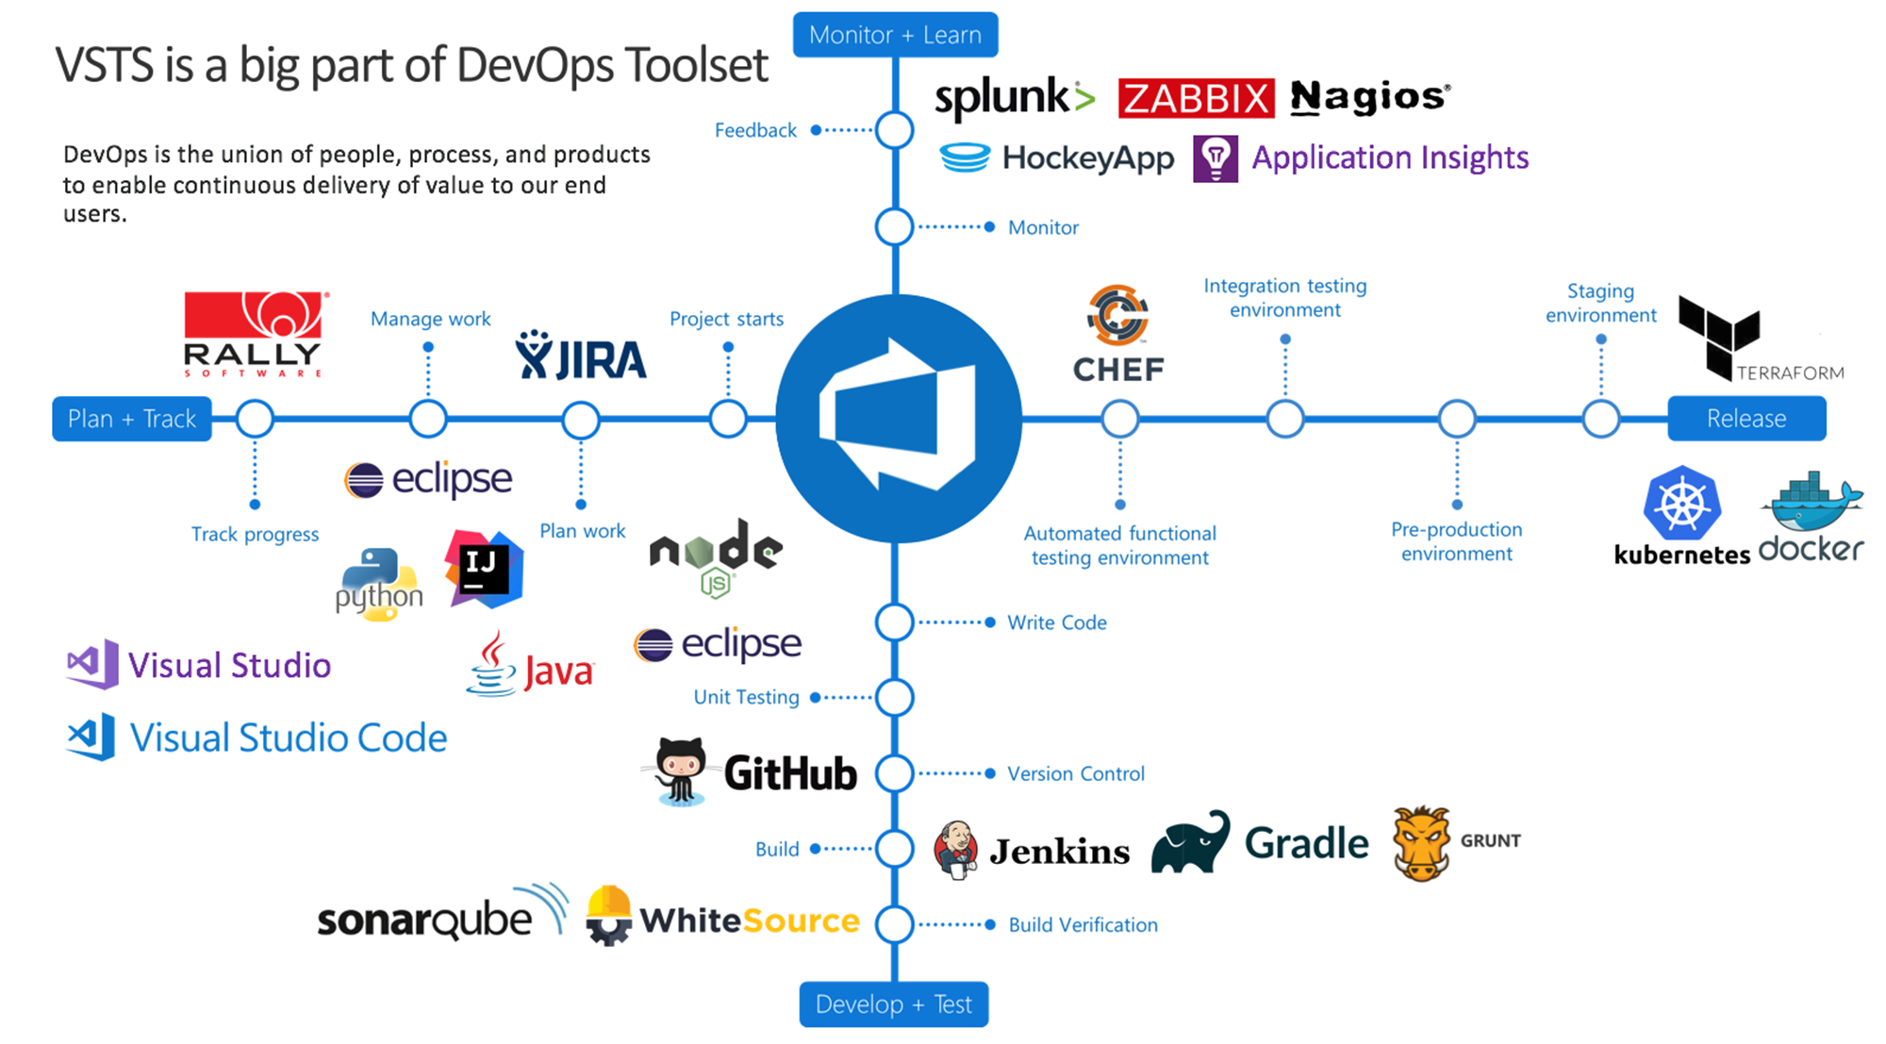

Slide 27
Automation

Slide 28
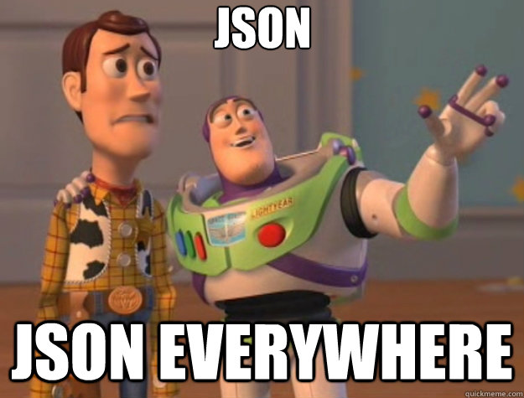

Slide 29
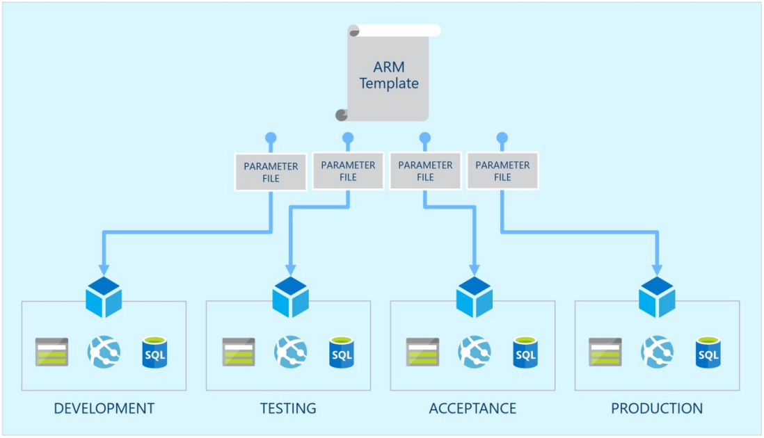

Slide 30
Automation
Plan: end-to-end
Split project into smaller parts
Automate everything (daily tasks automation)
Native solutions (Microsoft)
Third-party solutions (Ansible, Chief, Puppet,Terraform)
IaC
Plan

Slide 31
Real life example

Slide 32
Summary
Learn to learn
Knowledge sharing
Following new technology
Time for self-development (solution, test, skills)
Cooperation between teams
As a result one common vision
Automation, automation, automation

Slide 33
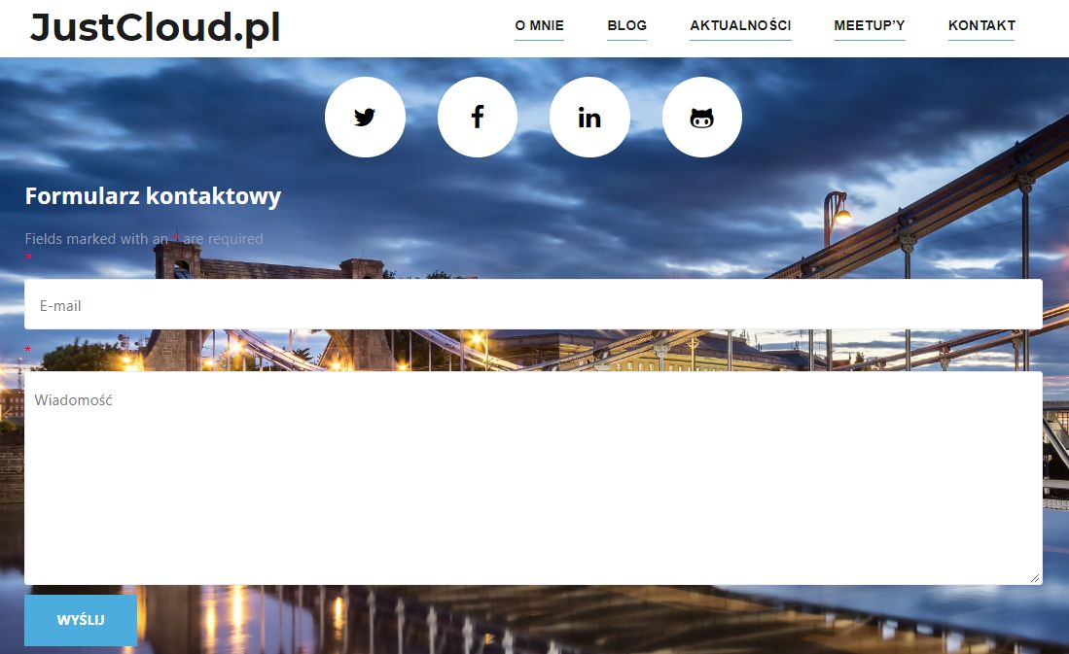
Questions?

